Slide 1
BLETCHLEY PARK 2023
A Microsoft 365 Community COLLABORATION CONFERENCE
Wednesday, 27th September 2023
Managing the lifecycle of documents in Microsoft 365
Agenda
Peter Baddeley

Slide 2
BLETCHLEY PARK 2023
Silver
Community Sponsors
Platinum
Gold
Silver
Thank you to all our Sponsors

Slide 3
About Me
SharePoint, Microsoft 365 and Dynamics
Founder of ProvisionPoint
Contact Me
ask@baddaz.com
@baddaz
baddaz.com
linkedin.com/in/baddaz/

Slide 4
About You

Slide 5
About this Session
Does Microsoft 365 offer an end to end process for managing the lifecycle of a document
Its not supposed to be a deep dive
Its about understanding the options and the gaps
What skills you will need
Create
Approve
Classify
Manage
Retain
Dispose

Slide 6
Create & Approve

Slide 7
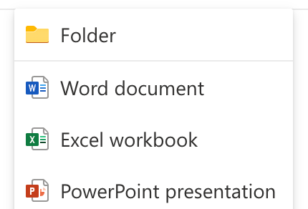
Create Files
Upload
New Document
From Office Applications
OneDrive Sync
Integrations and Automation

Slide 8
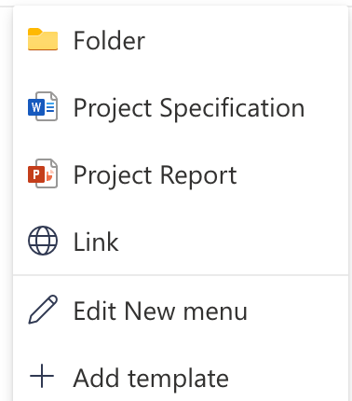
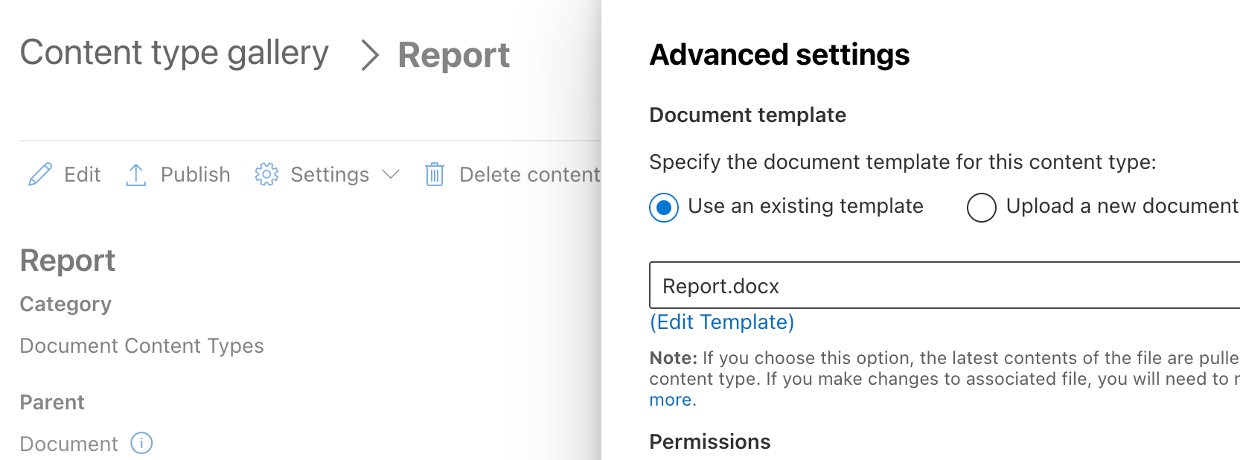
Templates
Library Templates
Content Types
Organisation Assets

Slide 9
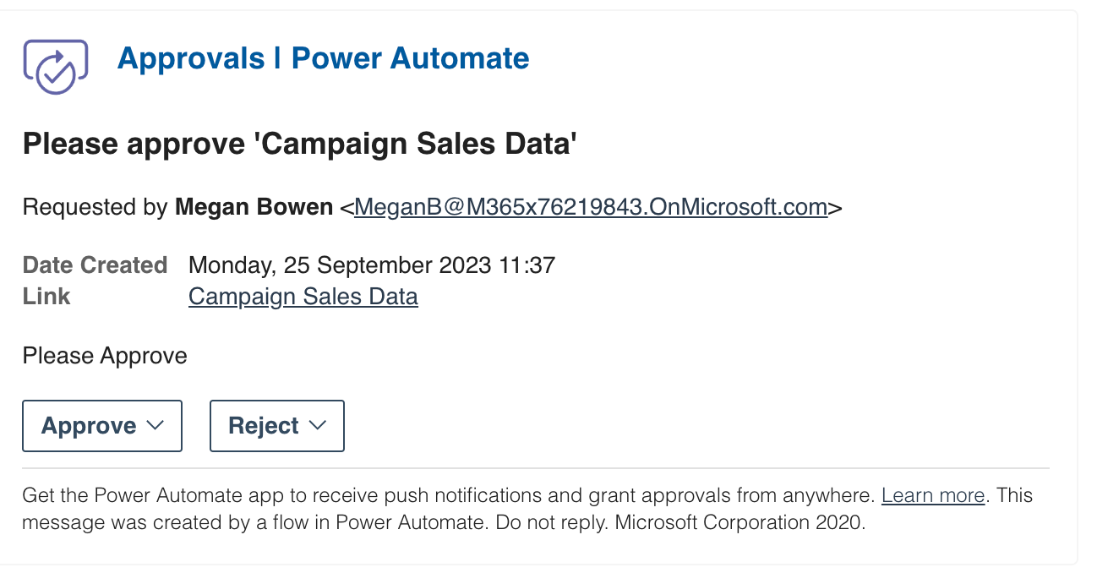
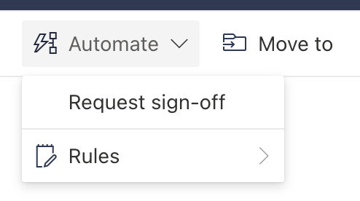
Approvals
Request Sign Off of a File
Trigger a Flow using Microsoft Approvals

Slide 10
Approvals App
An app in Microsoft Teams
A central location for all approvals
More organised than email

Slide 11
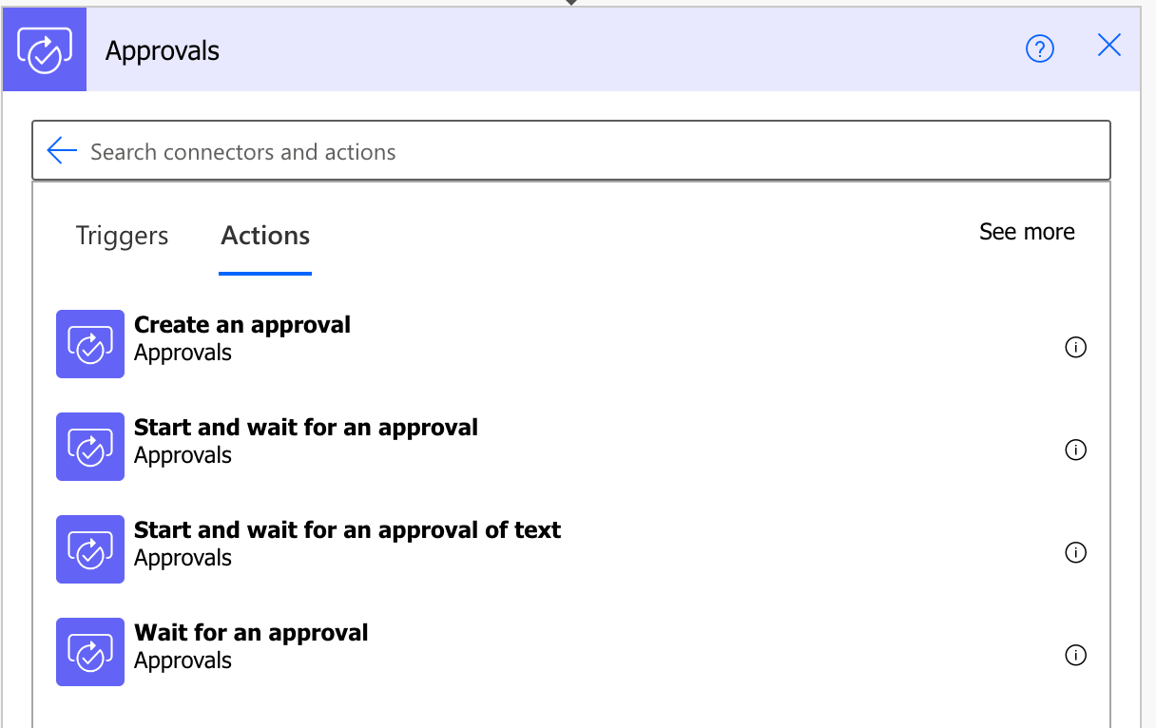
Building an Approval
Define your own trigger
Range of Actions
Multi-stage approval
Define the outcomes

Slide 12
Classify & Manage

Slide 13
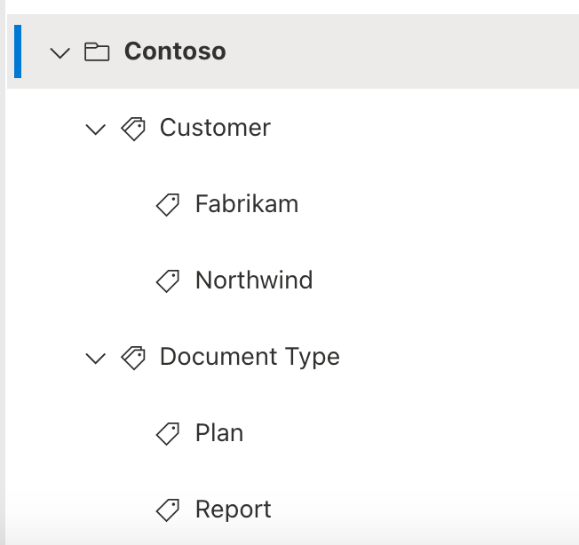
Tagging
SharePoint Term Store
Classify and Find Documents

Slide 14
Secure
Sensitivity Labels
For files
Control access to the Site

Slide 15
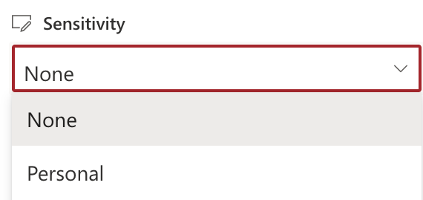
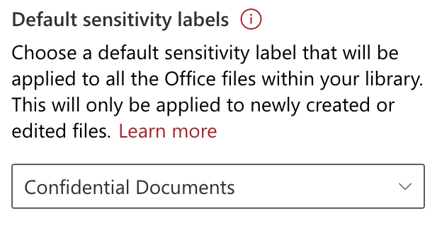
Apply Sensitivity Labels
Apply to a Document
Default for a Library
Auto Labelling

Slide 16
The in between Time
What happens between creation and disposal
Depends on the type of document
Do you care about the document or does it need regular review
Project Working Documents
Lightweight Collaboration
Policies and Procedures
Pricing or Marketing

Slide 17
Managing Document Change
Version Control
Check In/Out
Sharing Files

Slide 18
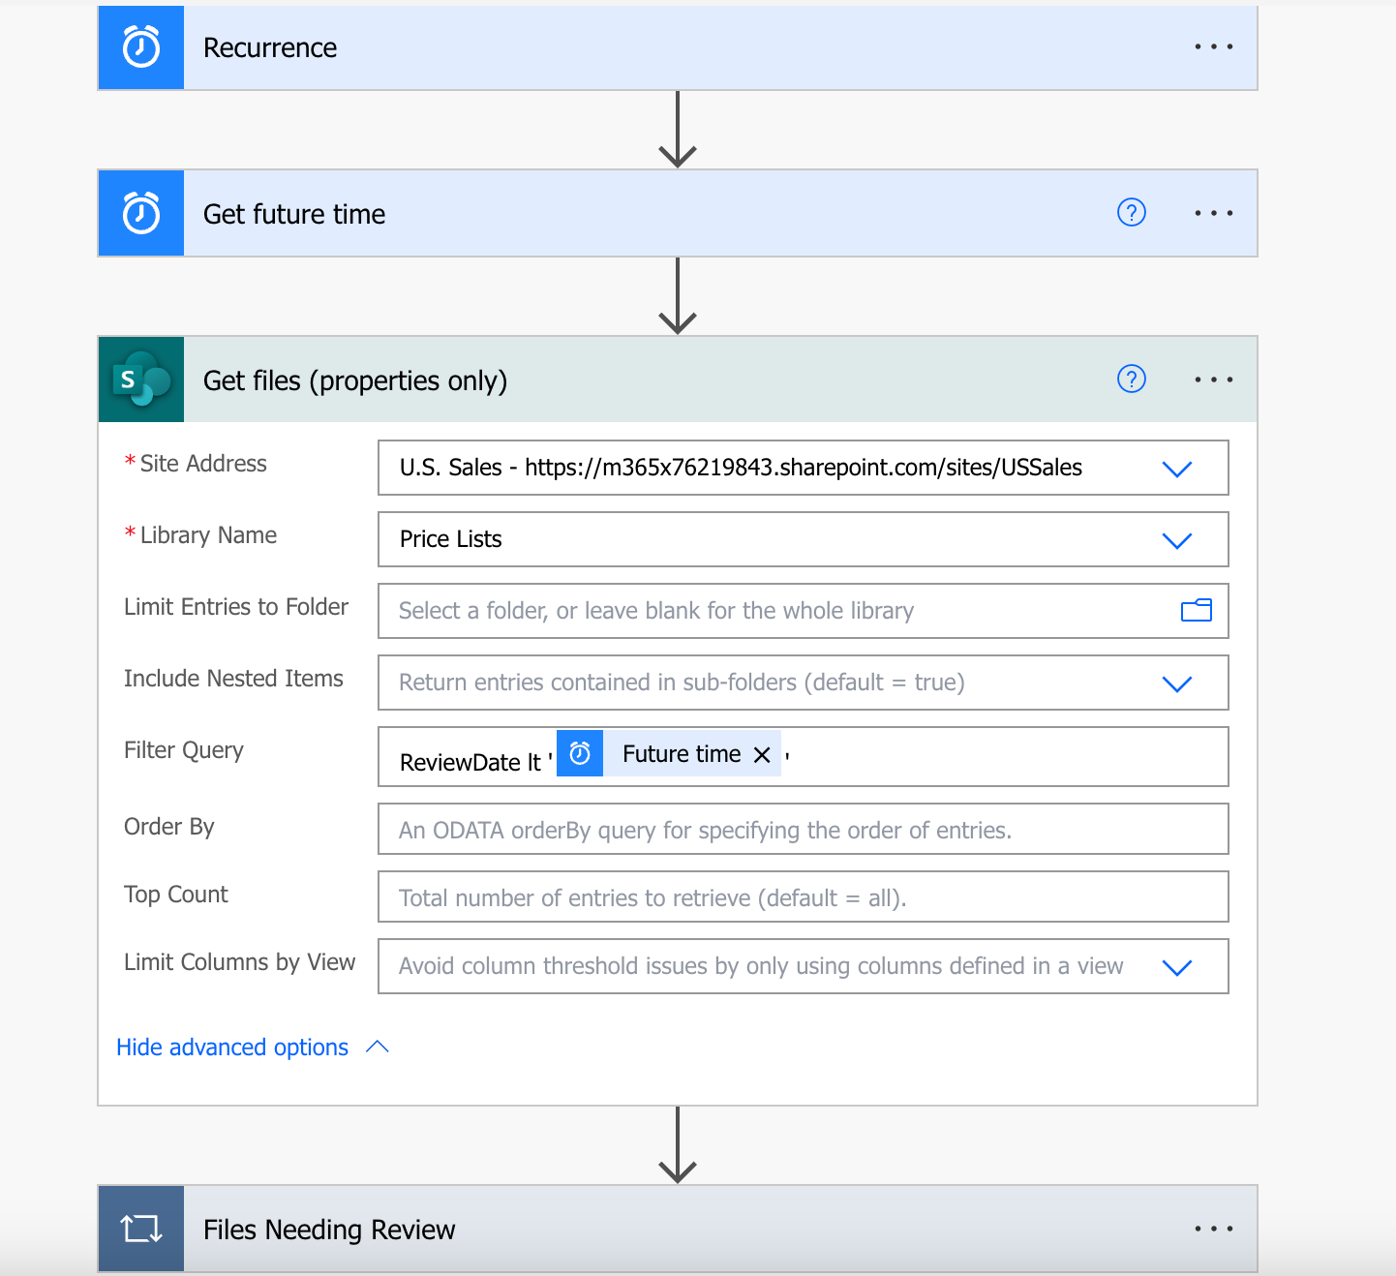
Automate Document Review
What if a document needs to be reviewed?

Slide 19
Retain & Dispose

Slide 20
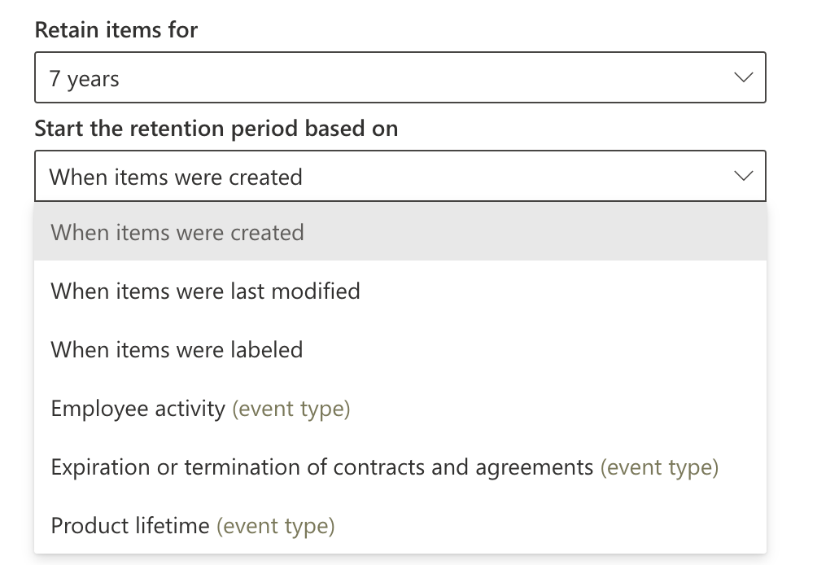
Retention Labels
Implement document retention based on needs
Retain, Enforce Actions or Just Label
Define when retention period starts

Slide 21
Retention Labels
Define what happens at end of retention

Slide 22
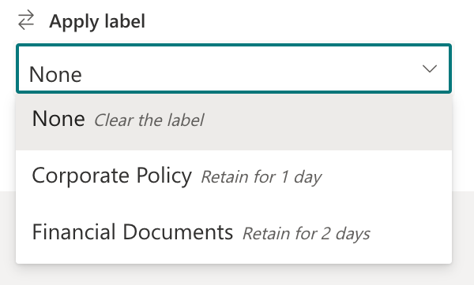
Applying Retention Labels
User choice
Library Level Defaults
Query or a Type of Data
Microsoft Syntex

Slide 23
Applying Retention Labels
Control which Sites have which Labels
Site URL can be used

Slide 24
Automation
Trigger a Flow
Retention Label Actions

Slide 25
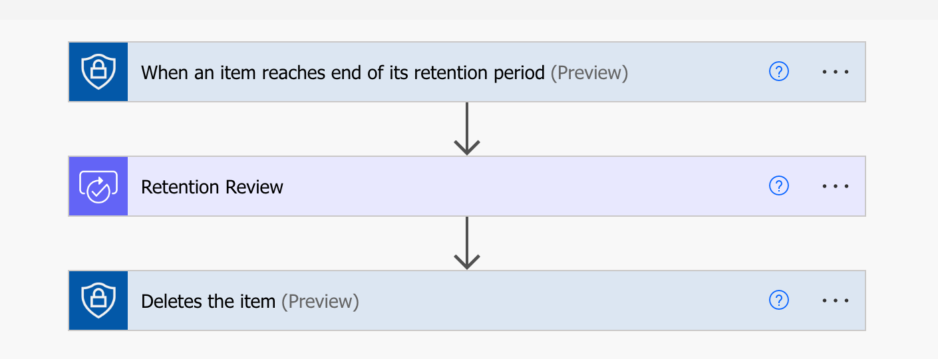
Automation
Leverage approval and perform actions
Move a file and then retain
Change the label

Slide 26
Summary

Slide 27
Lifecycle of a Document
Does Microsoft 365 offer an end to end process for managing the lifecycle of a document?
Create
Approve
Change
Manage
Retain
Dispose
Templates & Approvals
Versions & Sensitivity
Retention Labels
Power Automate

Slide 28
Summary
Not all documents follow the same lifecycle
Microsoft 365 provides incomplete picture
There is a simple and complicated approach
Licensing is complex ☹
Is it Enterprise ready?

Slide 29
Questions

Slide 30
Resources
https://learn.microsoft.com/en-us/sharepoint/organization-assets-library
https://learn.microsoft.com/en-us/business-applications-release-notes/april18/microsoft-flow/request-sign-off-flow-built-into-sharepoint
https://learn.microsoft.com/en-us/purview/get-started-with-sensitivity-labels
https://learn.microsoft.com/en-us/purview/records-management
https://learn.microsoft.com/en-us/purview/get-started-with-records-management#subscription-and-licensing-requirements

Slide 31
Get in Contact
ask@baddaz.com​
@Baddaz​
baddaz.com
linkedin.com/in/baddaz

Slide 32
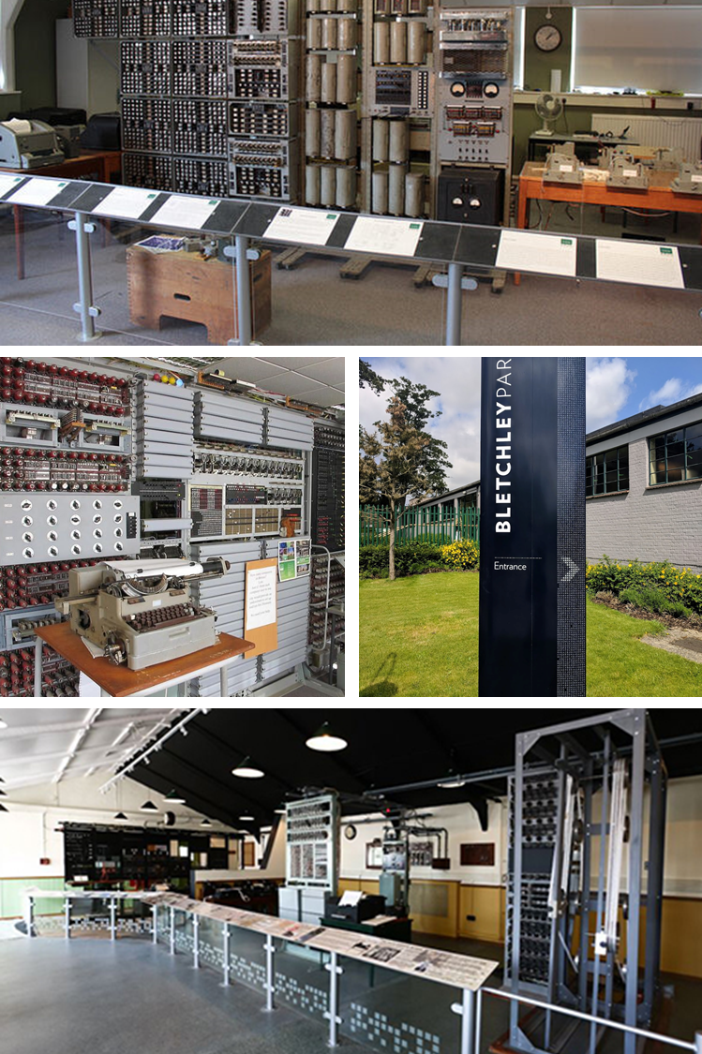
BLETCHLEY PARK 2023
Thank You!

